Slide 1
Getting started with Github
A guide for CONNECT study investigators and other non-developers.
Daniel E. Russ, Ph.D.
Data Science Research Group,
Division of Cancer Epidemiology and Genetics, NCI

Slide 2

Github is a Web-Based Repository (GIT)
Document 1
The reign in Spain stays mainly on the plains.
Document 2
The unexamined life is not worth living
Version | Documents
2b73114 | Document 1 Document 2
Version | Documents
781efc8 | Document 1 Document 2
2b73114 | Document 1 Document 2
Document 1
The rain in Spain stays mainly on the plains.
Document 2
The unexamined life is not worth living

Slide 3
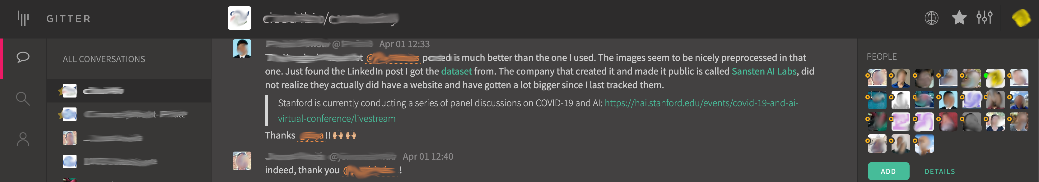
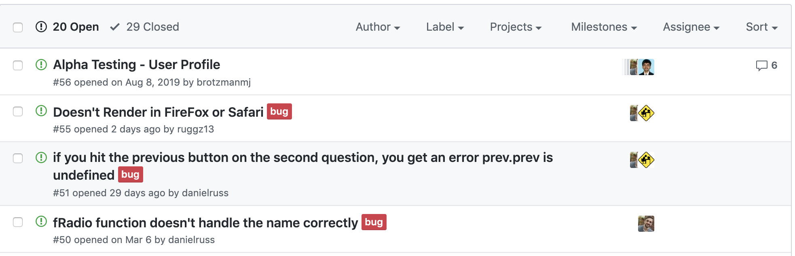
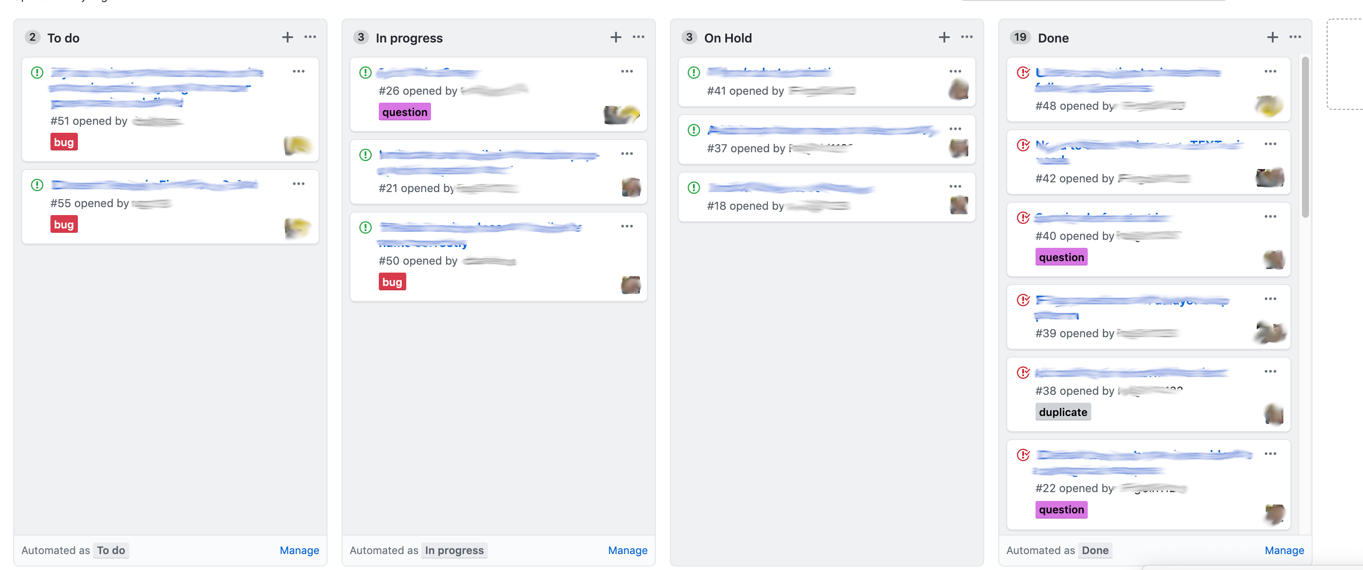
Github integrates communication with our repository
Gitter
Issues
Kanban Boards

Slide 4
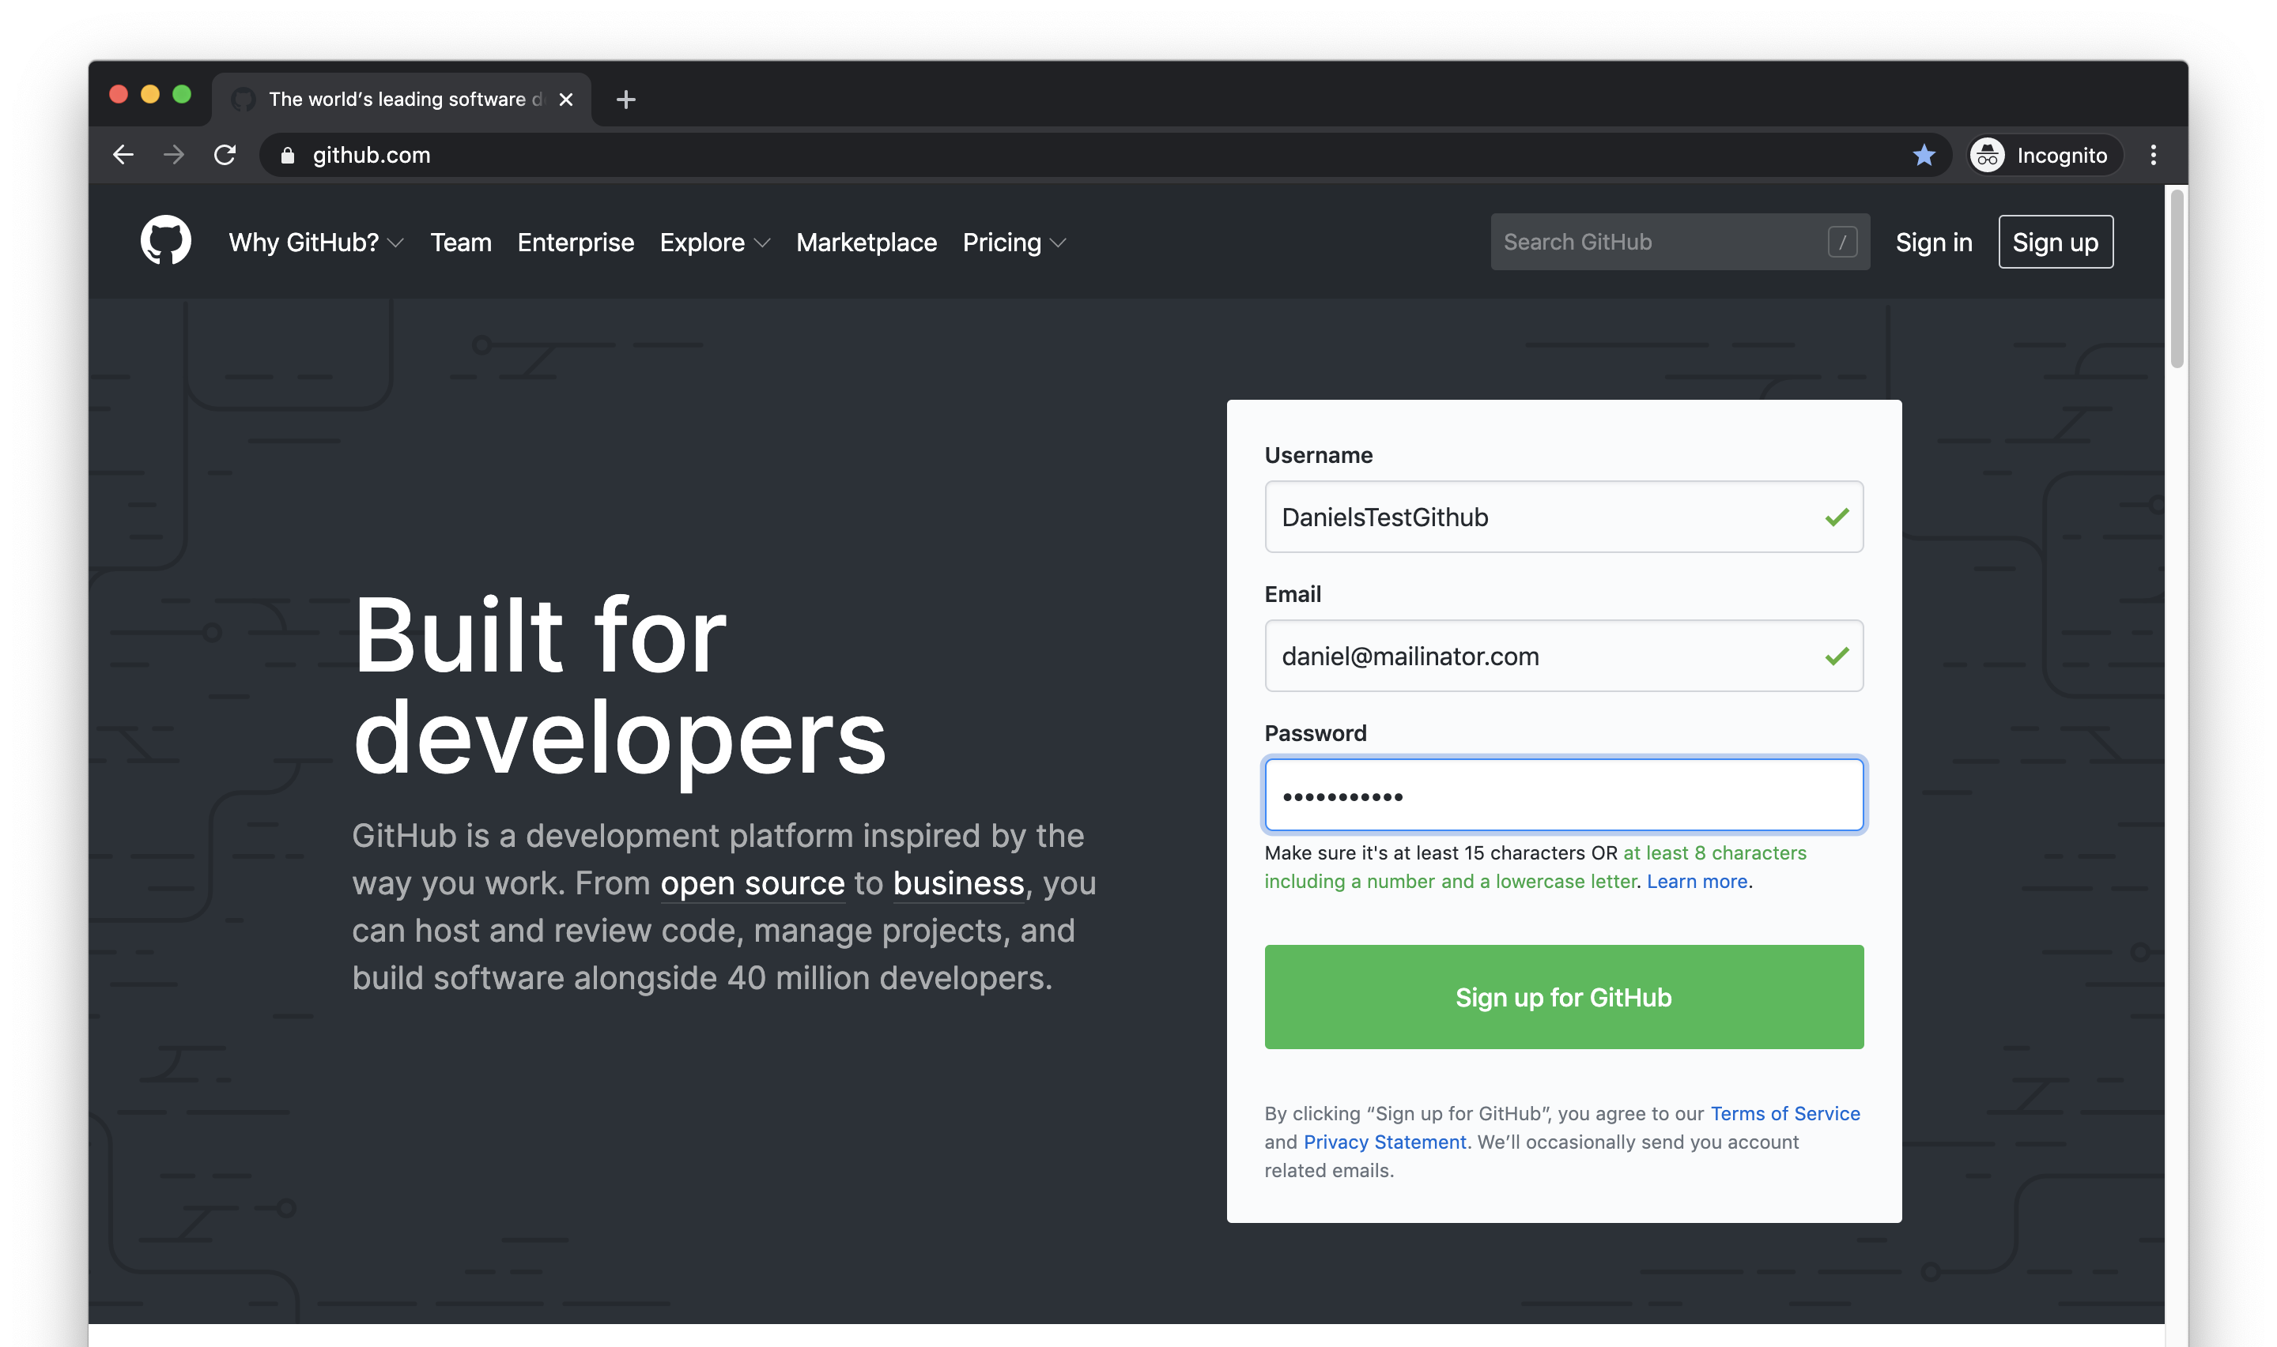

Slide 5
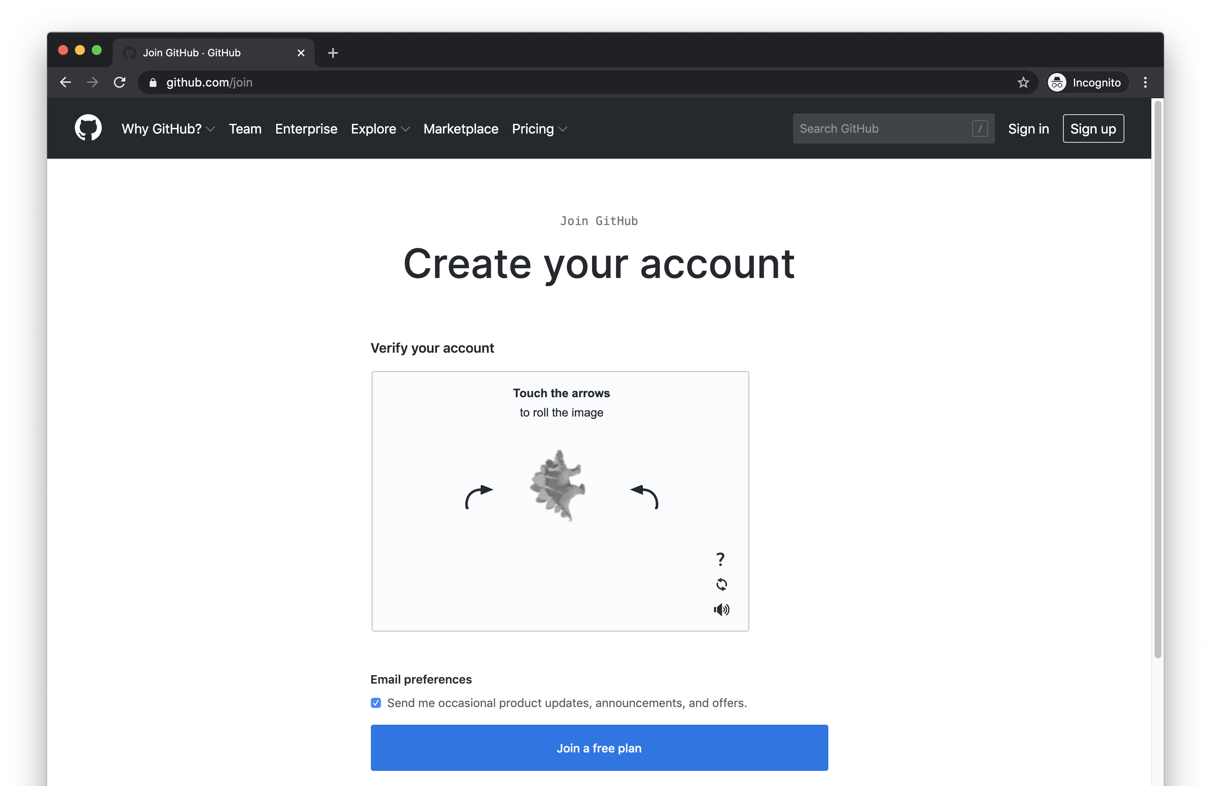

Slide 6
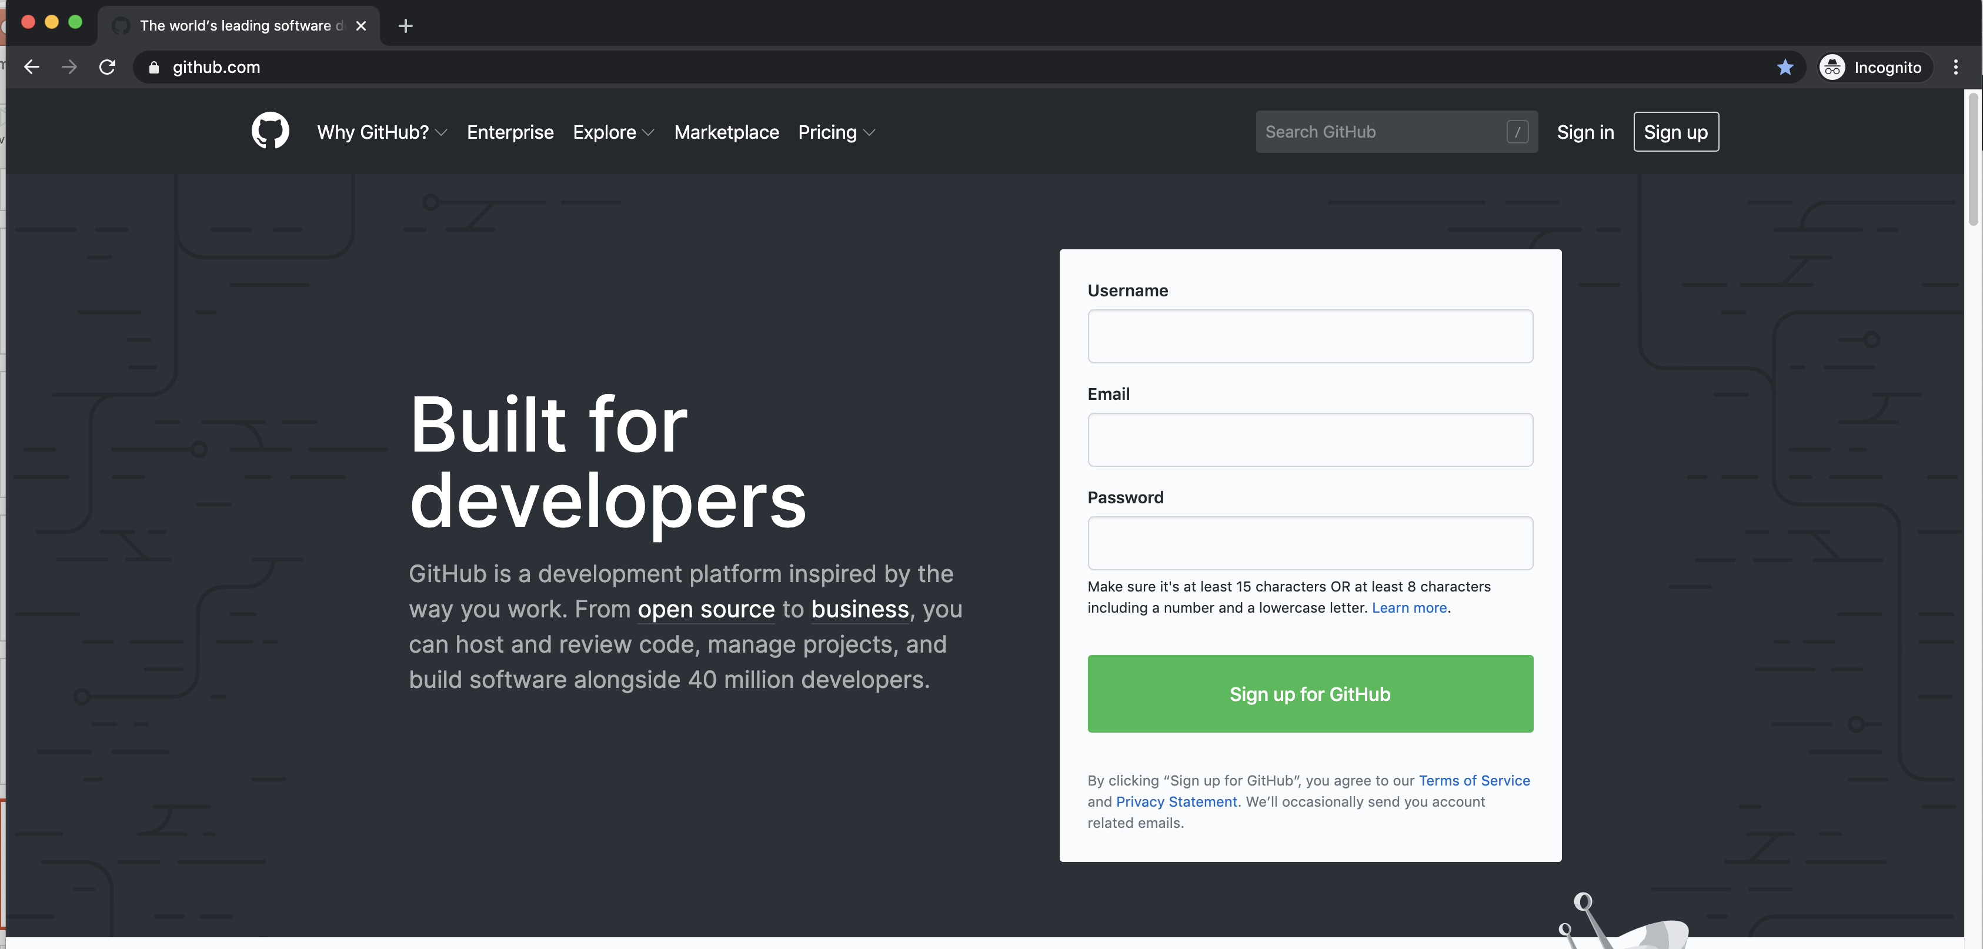

Slide 7
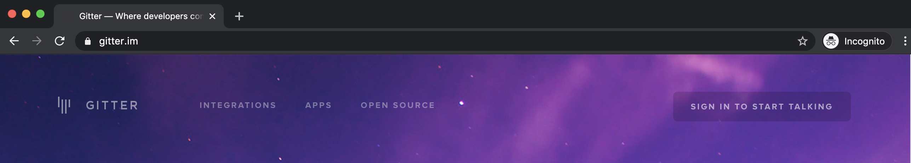
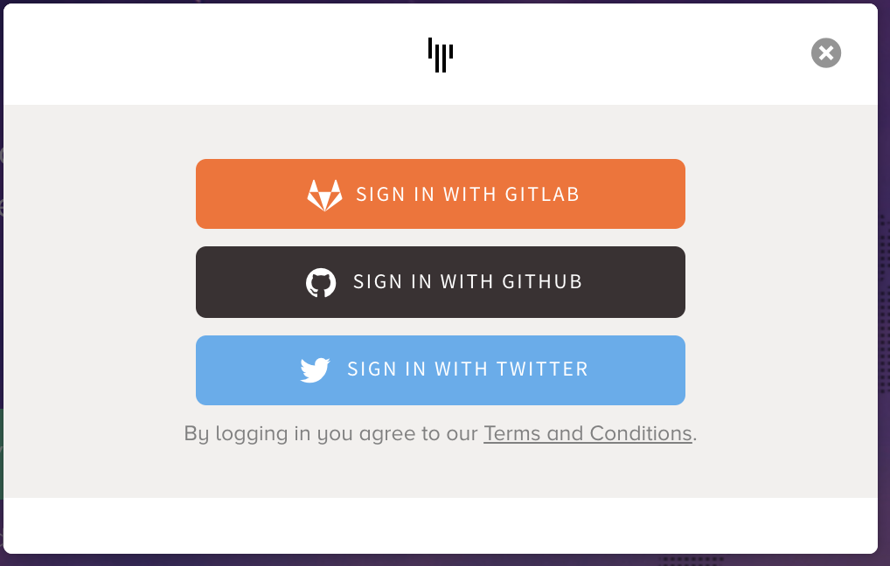
Communicating via Gitter https://gitter.im

Slide 8
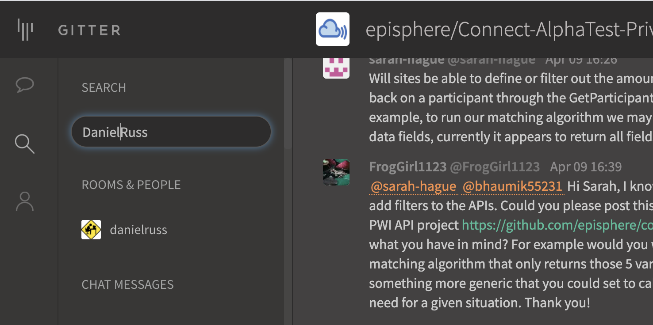
Joining our private gitter chat
Contact me: If I know you’re a Connect person, I’ll invite you. I’m in NED or search gitter.

Slide 9
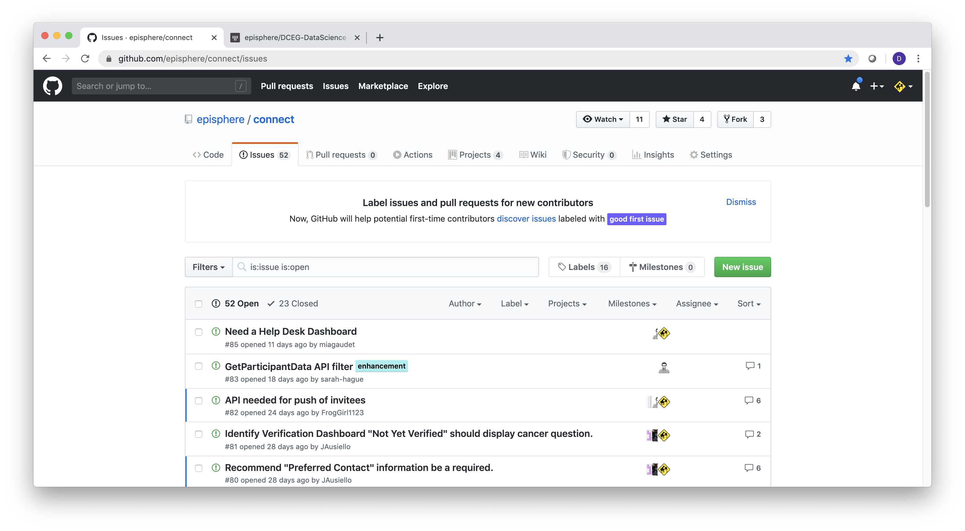
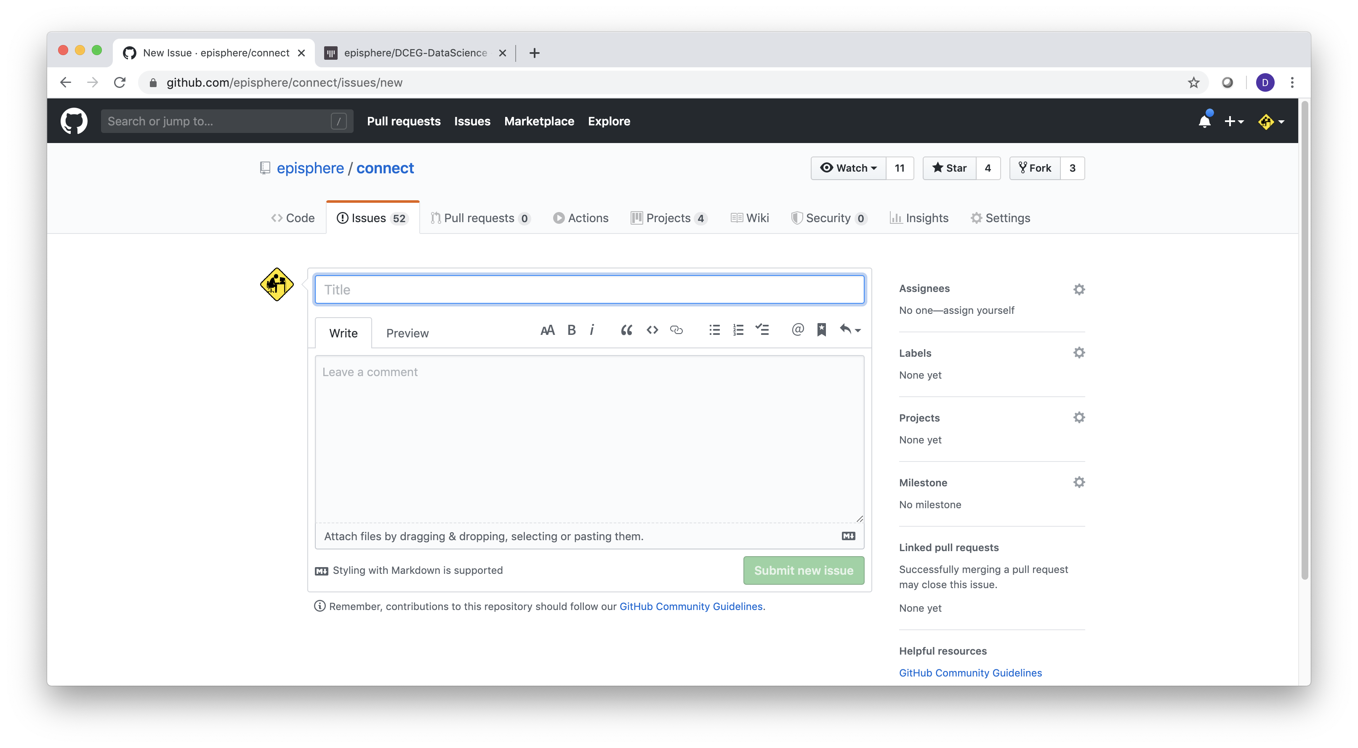
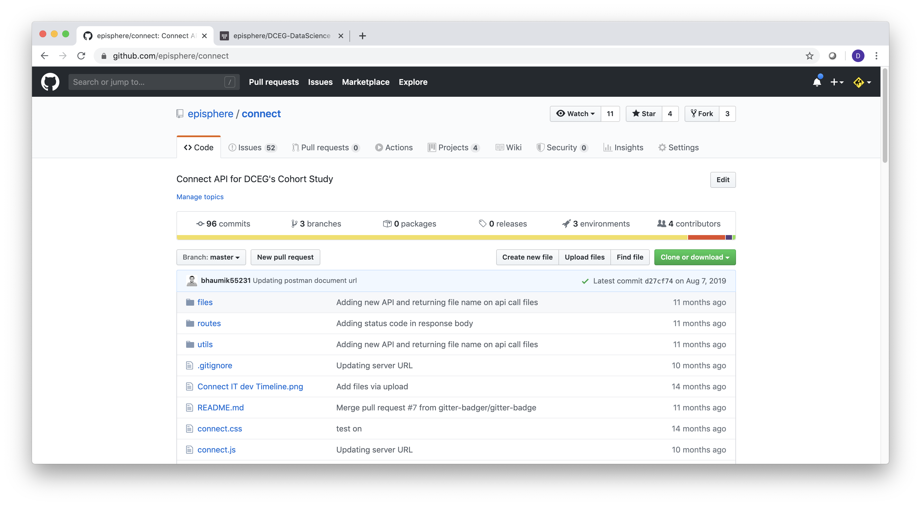
Creating an Issue (Bug report)
https://github.com/episphere/connect
Short description of the issue
detailed description of the issue

Slide 10
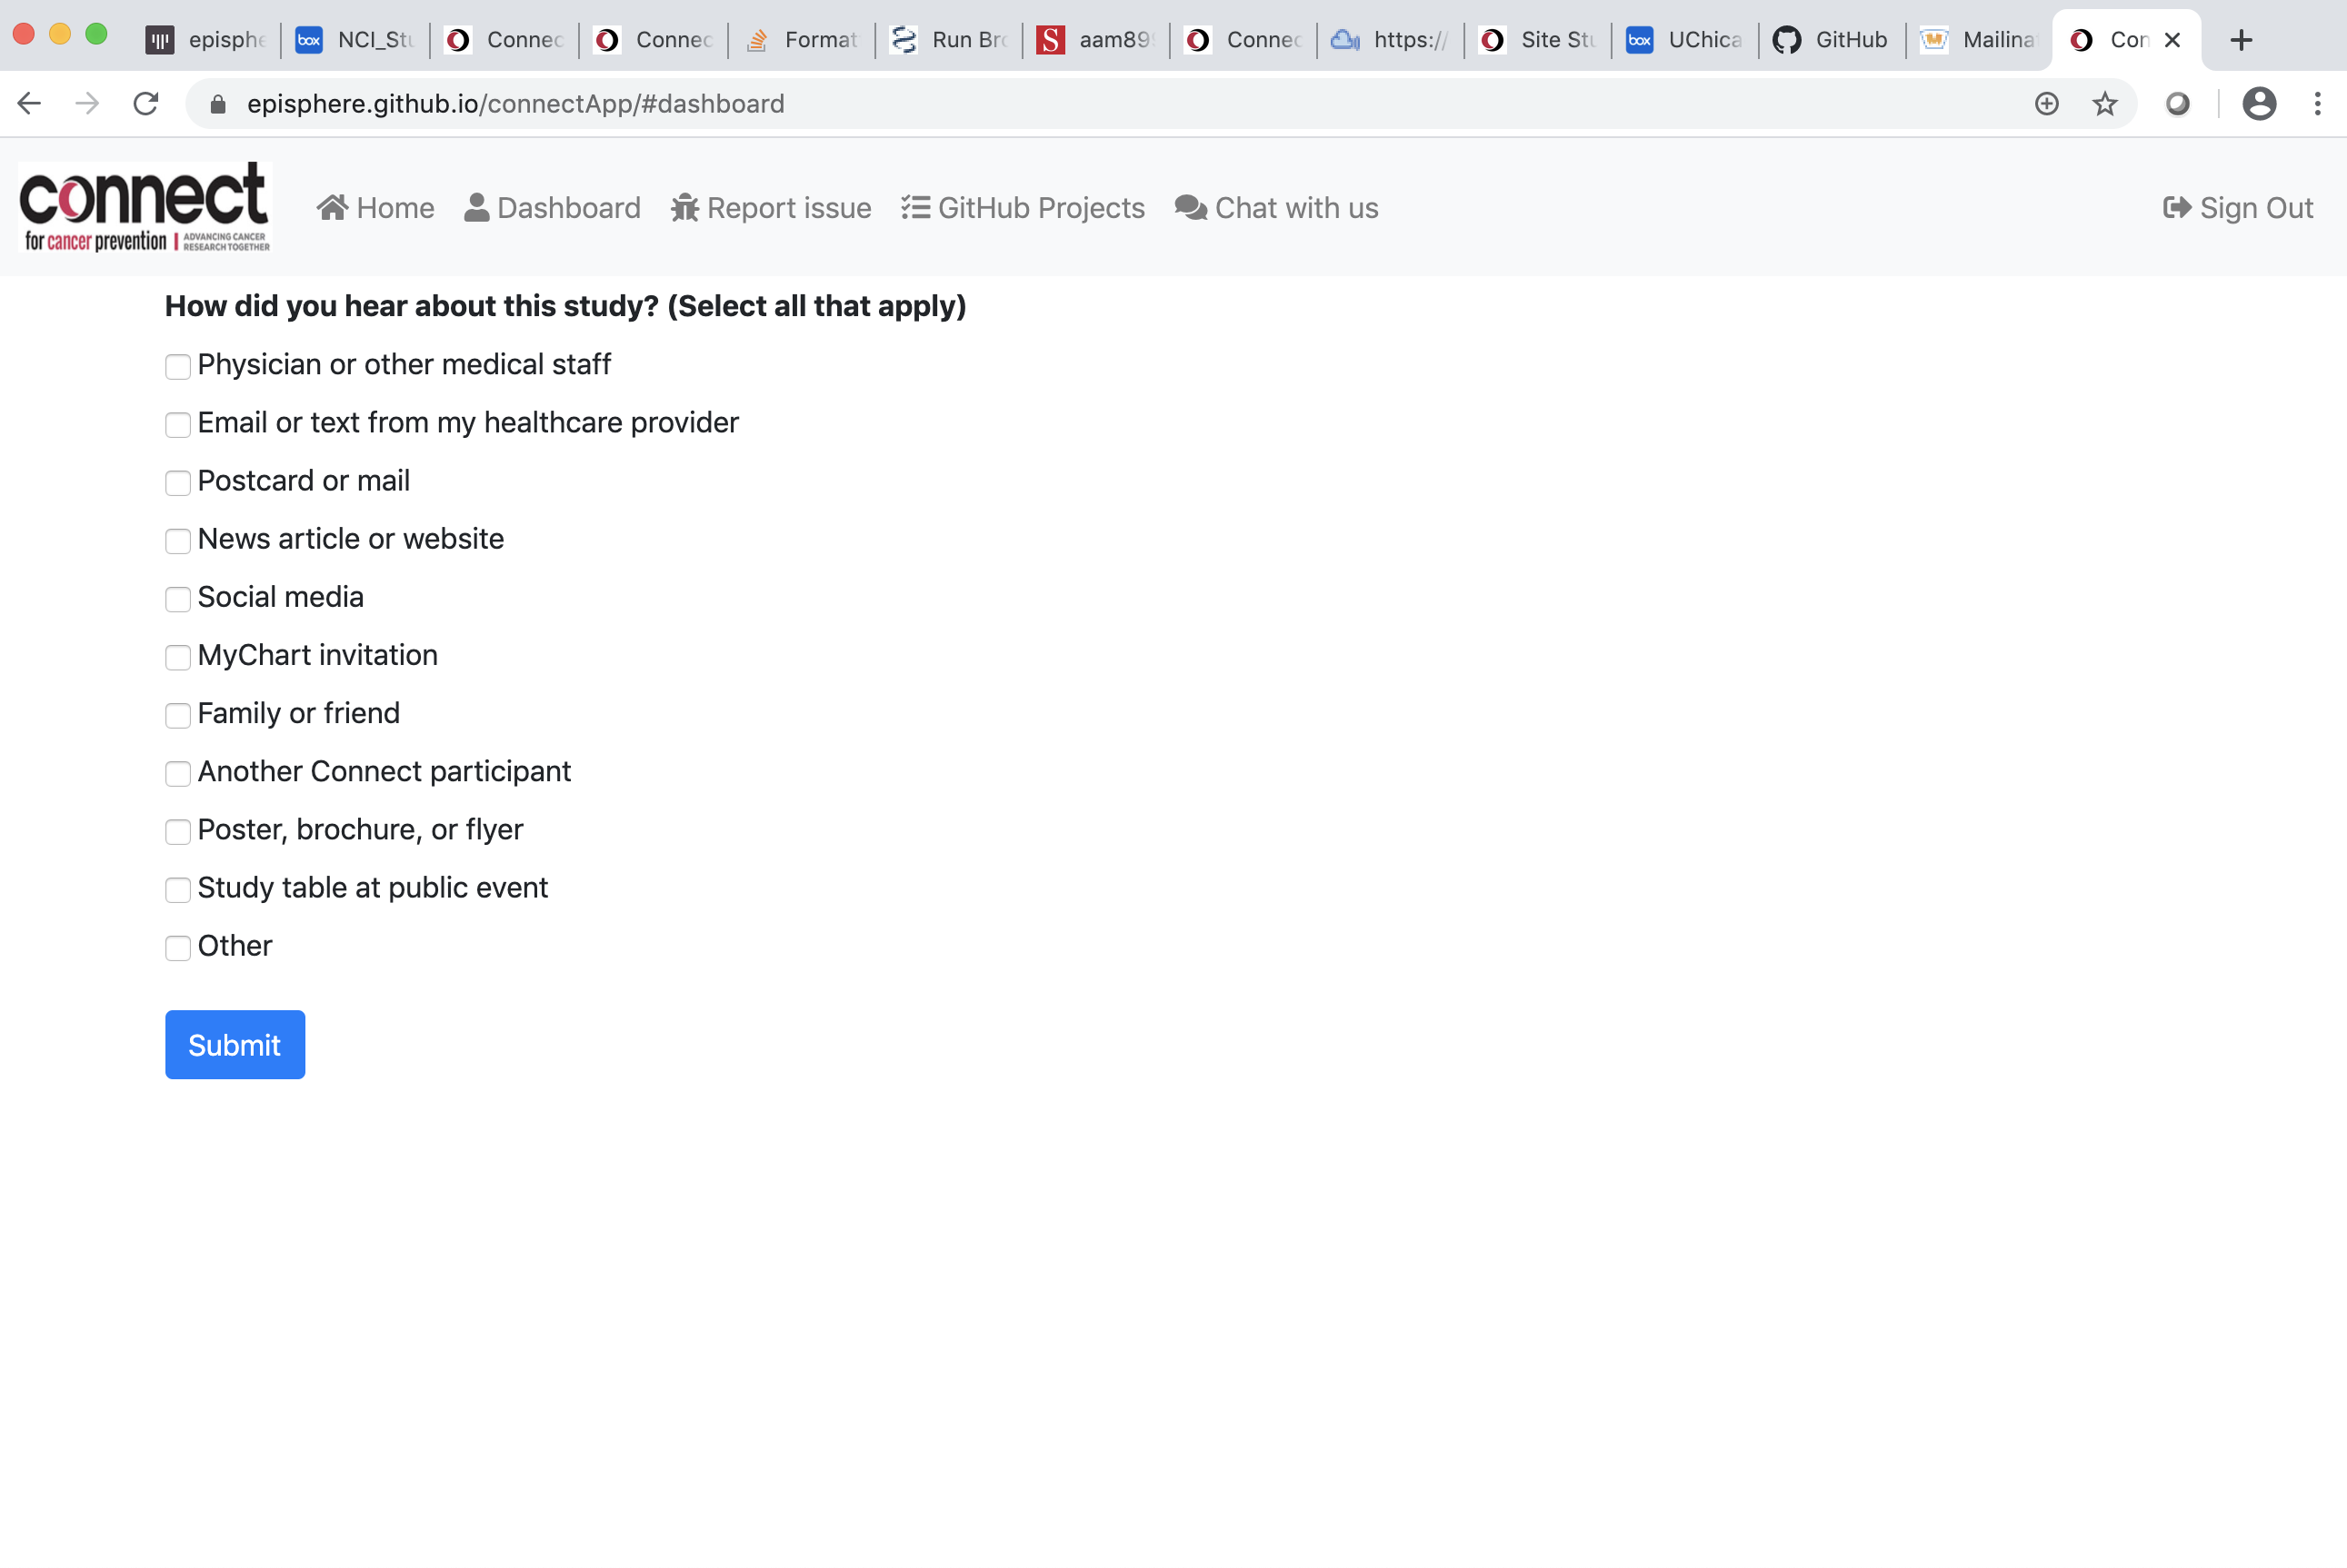
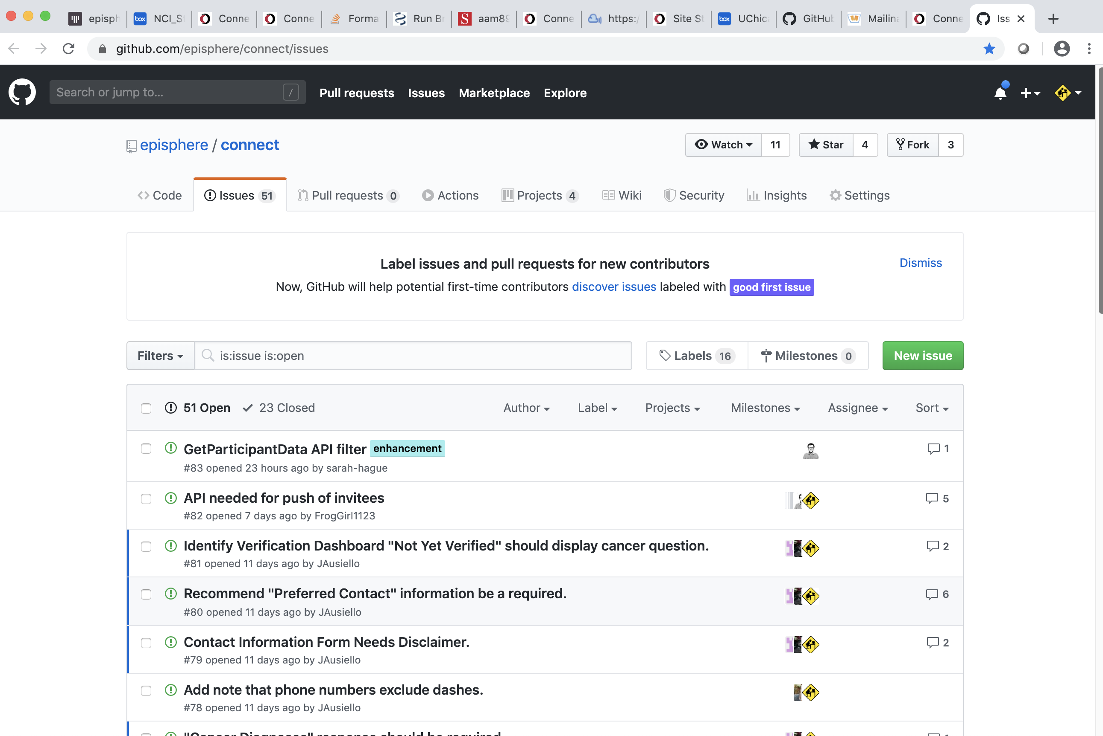
Creating an Issue from the PWA

Slide 11
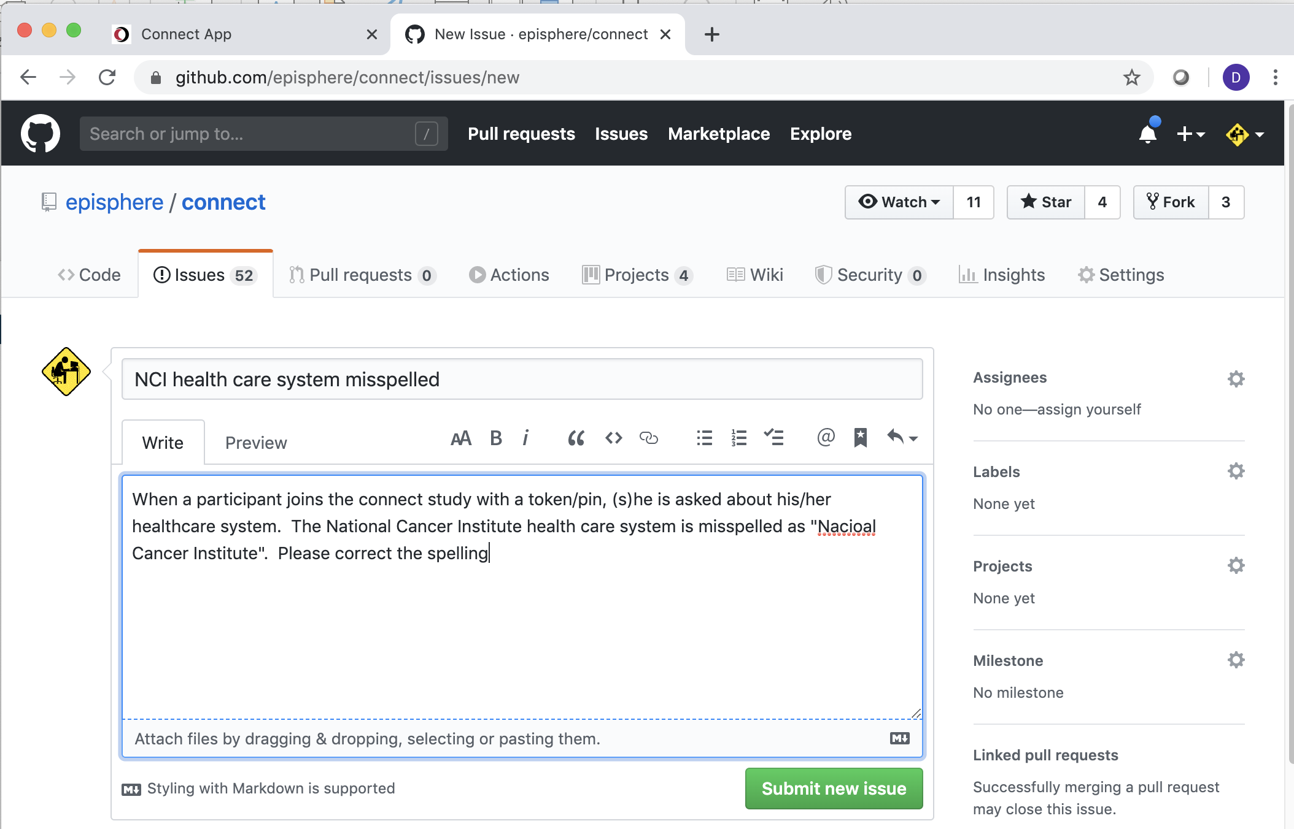
Creating an Example Issue

Slide 12
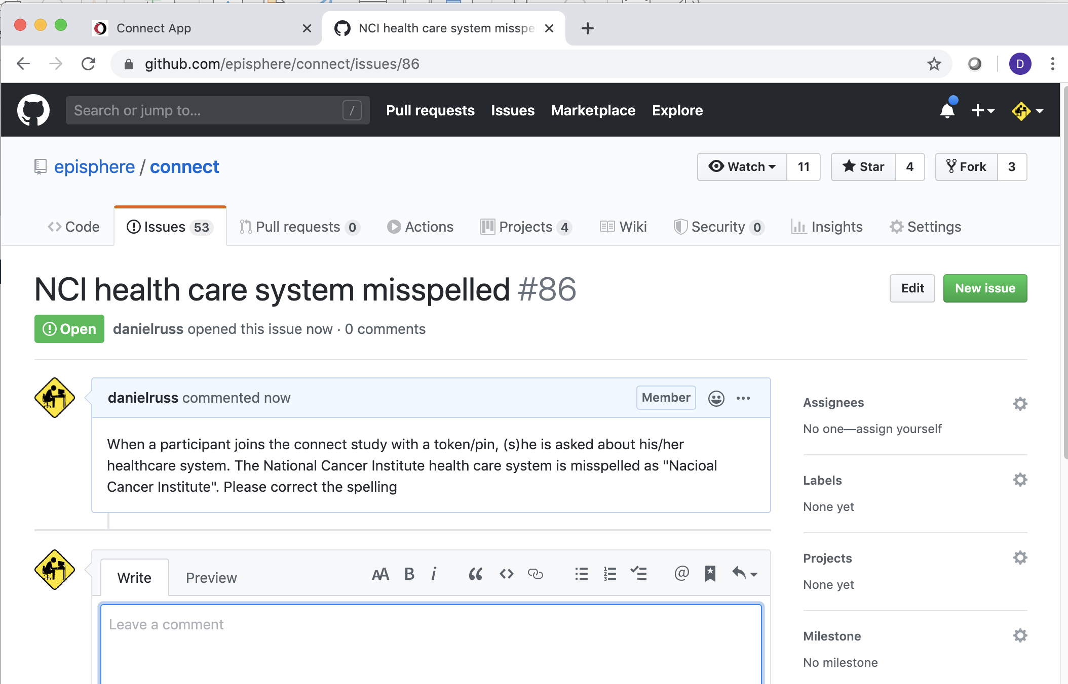
Creating an Example Issue

Slide 13
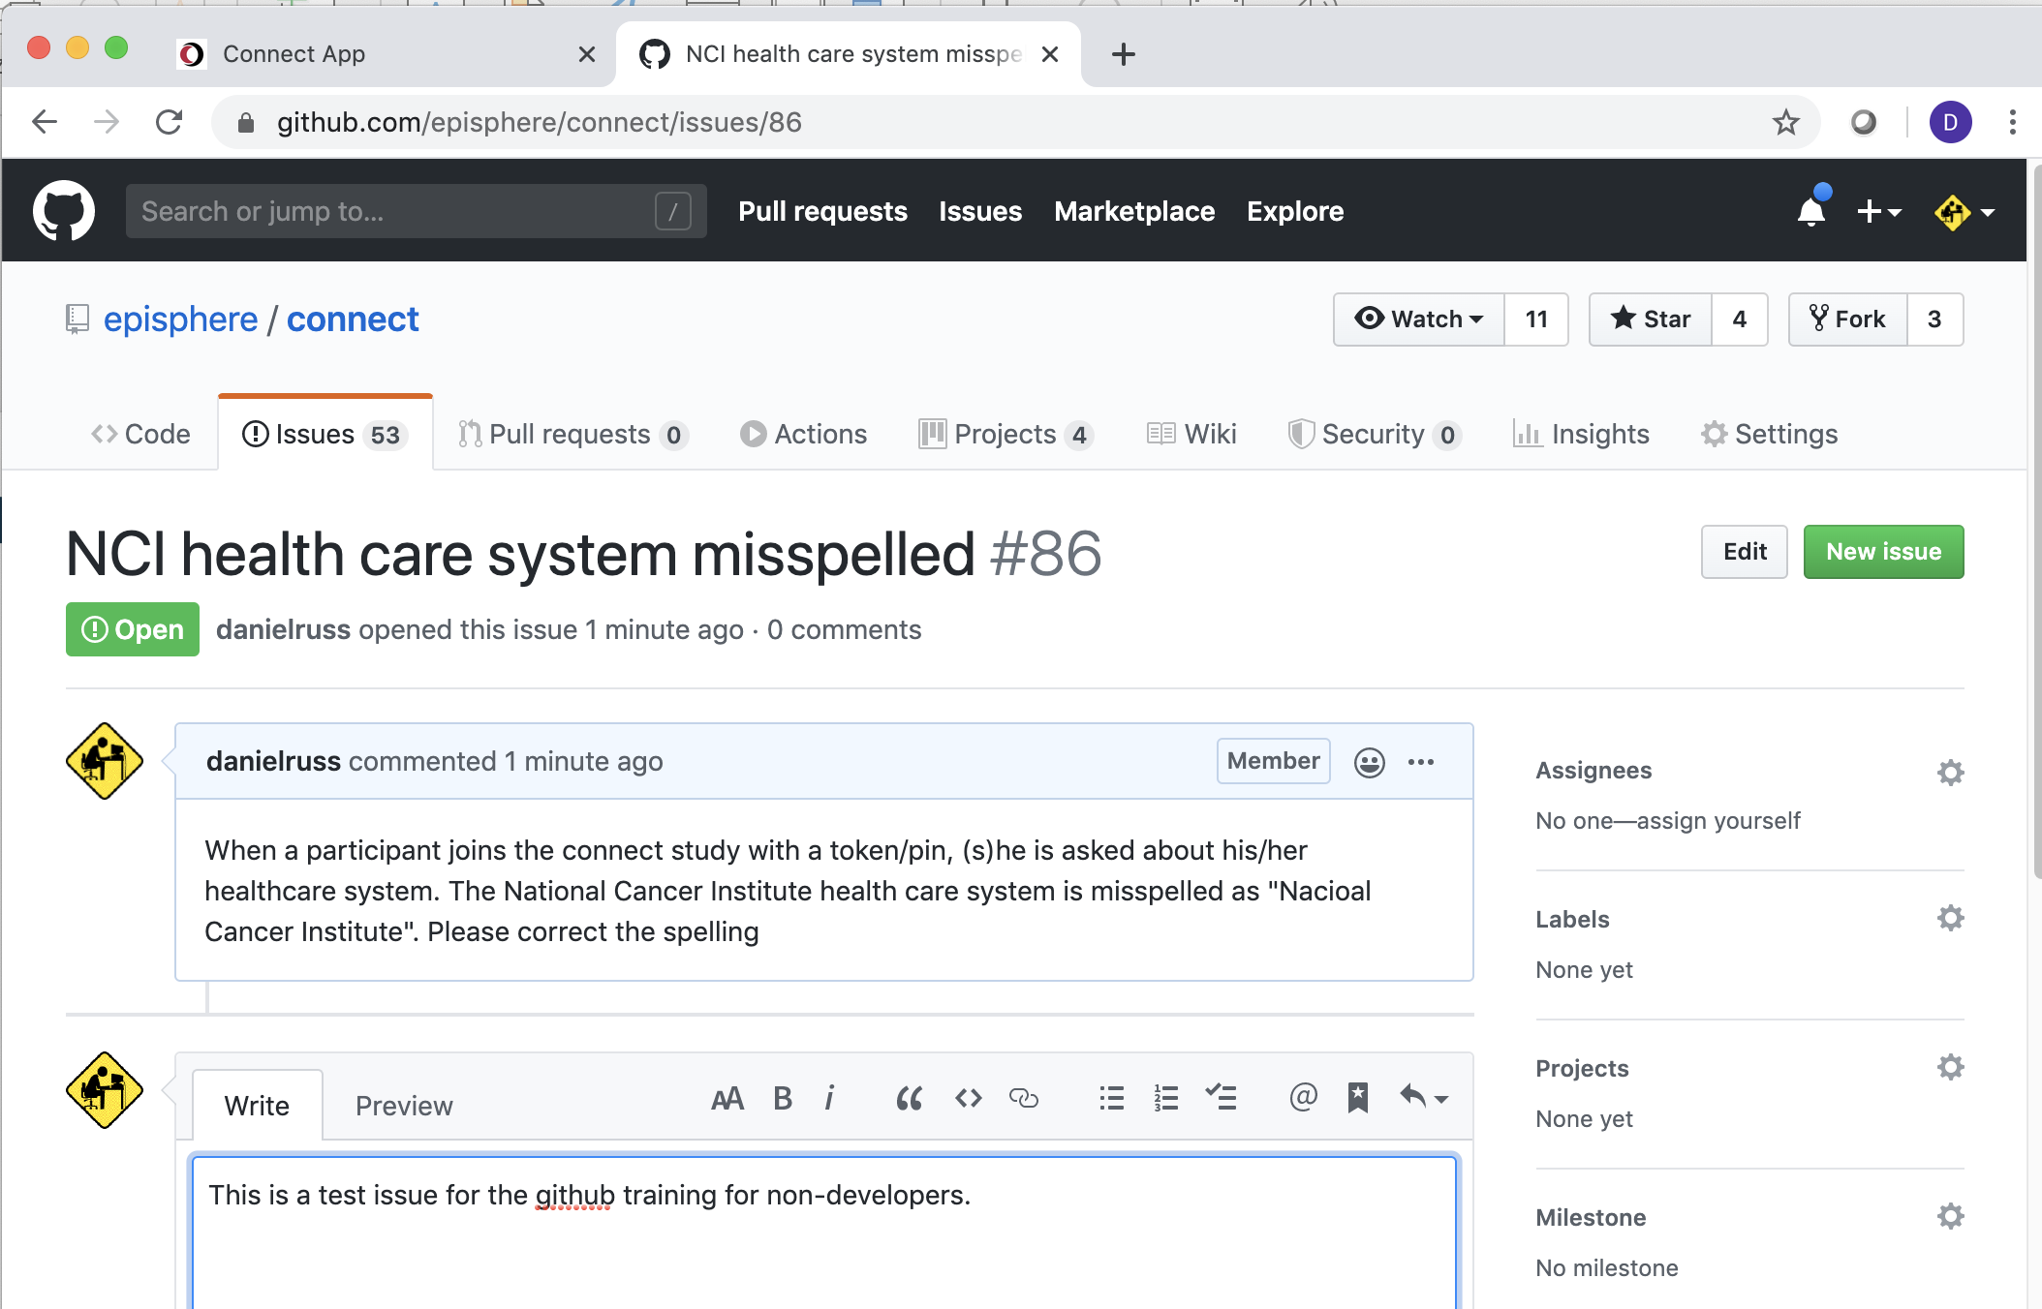
Creating an Example Issue

Slide 14
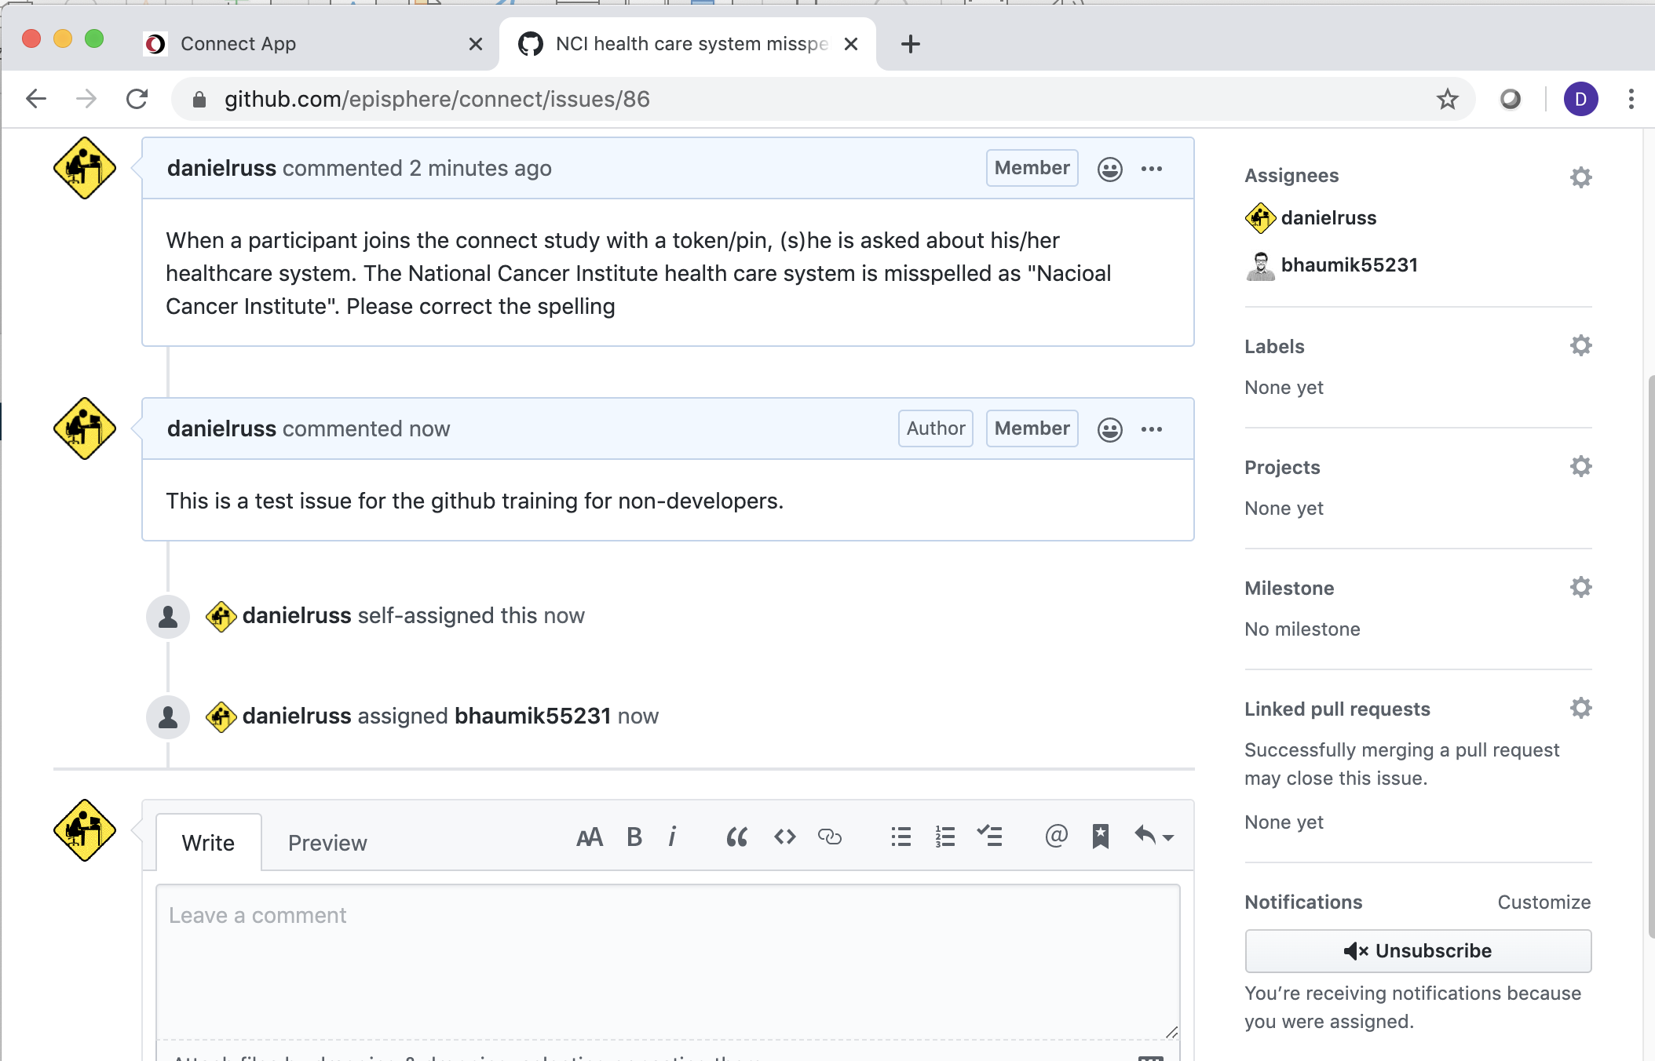
Creating an Example Issue

Slide 15
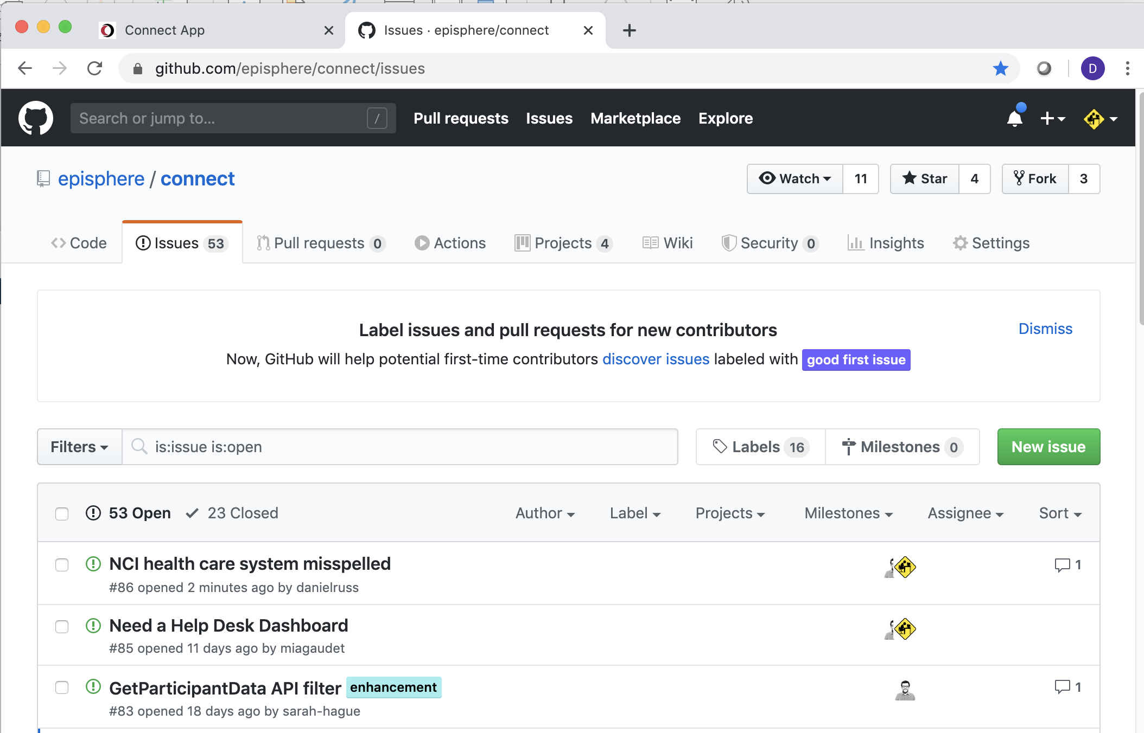
Creating an Example Issue

Slide 16
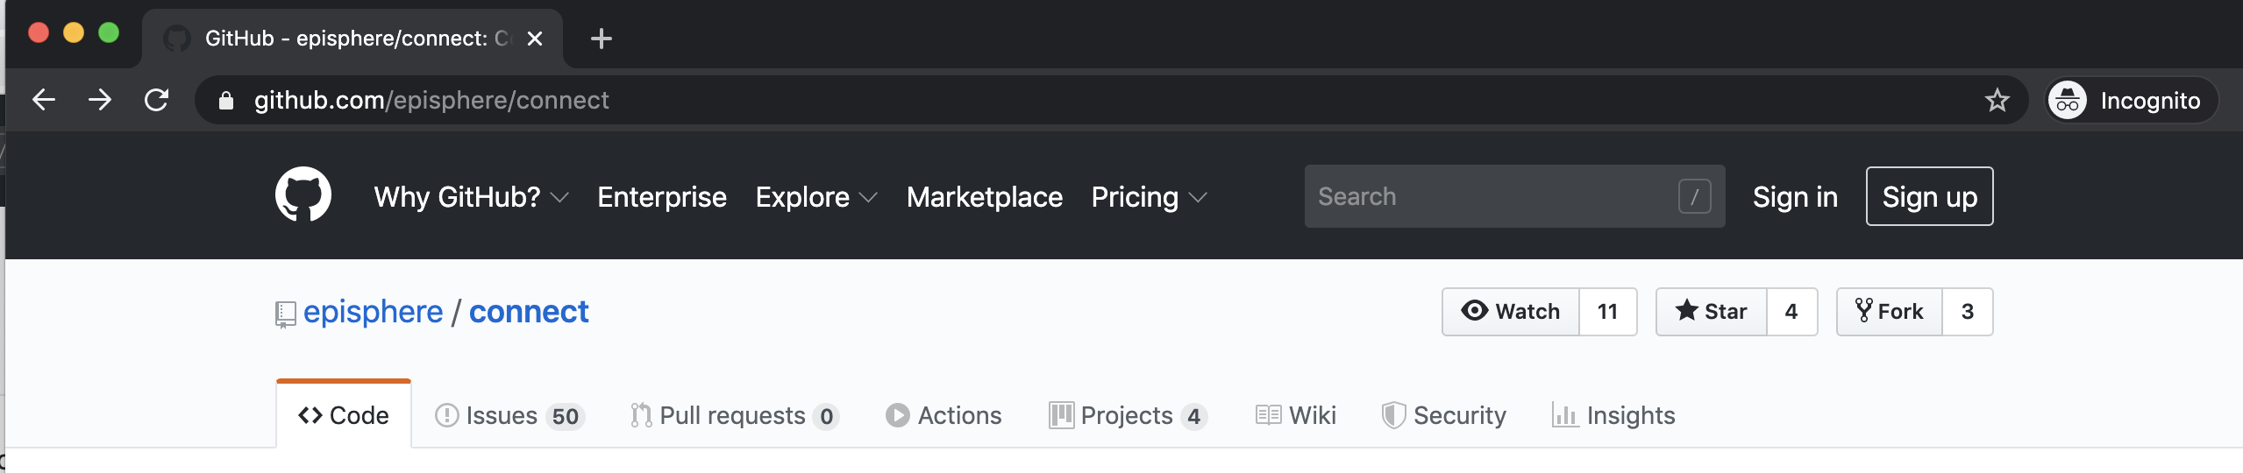
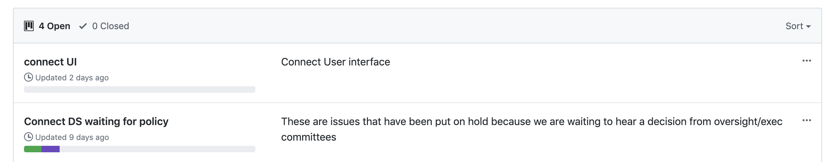
Tracking issues with the Github Kanban

Slide 17
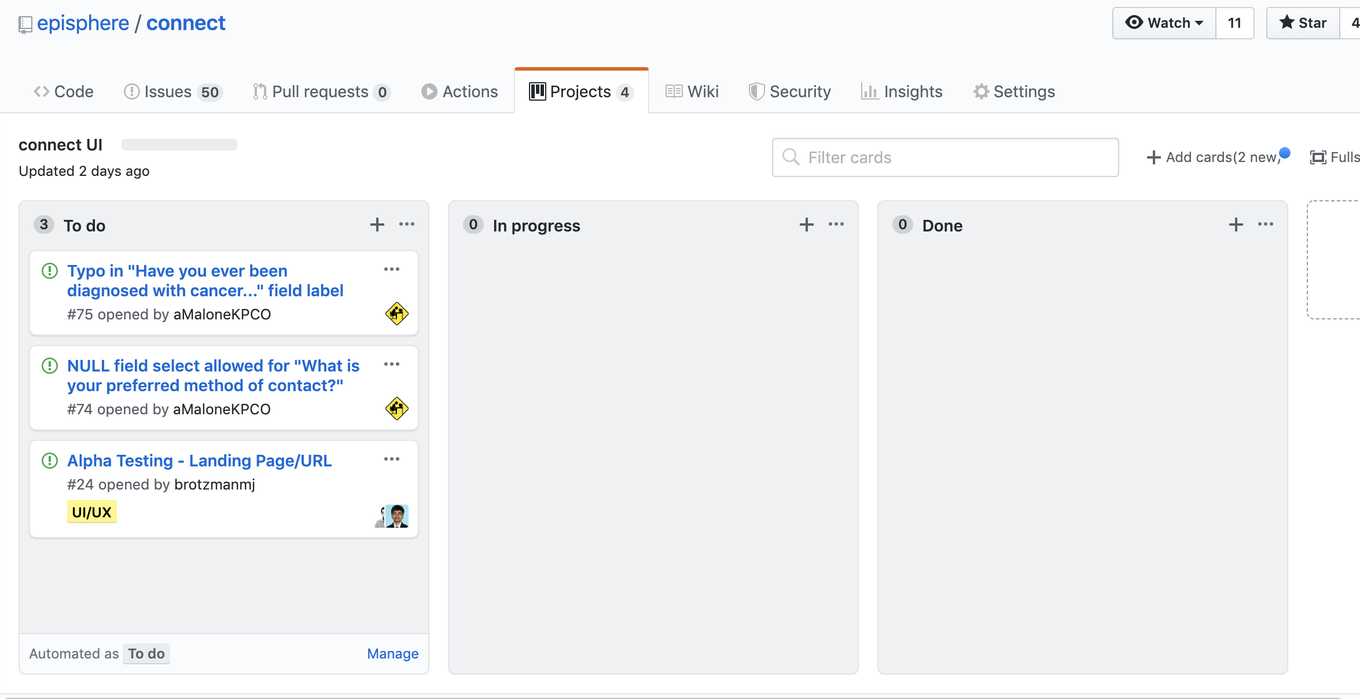
Cards can be dragged into other columns, or set up to do it automatically

Slide 18
Last comments and Questions???
This powerpoint is available in github.
Repository: https://github.com/danielruss/documentation
ppt: https://github.com/danielruss/documentation/GithubIntro.pptx click view raw
Have suggestions or corrections?
Create an issue

